Slide 1
A Modified Optical Flow Estimation Approach
410410004 Pin-Hsiu Lin 林品秀
410410057 Yu-Ren Wang 王昱人
410410086 Chen-Yu Ko 柯宸瑀
Department of Computer Science and Information Engineering
National Chung Cheng University
Notes:
1

Slide 2
Outline
Introduction
FlowFormer++
Proposed Approach
Experimental Results
Concluding Remarks
2
2
Notes:
2

Slide 3
Introduction
Optical flow estimation aims to find the 2D dense motion fields between two video frames.
Most optical flow estimation methods often rely on local clues, resulting in fragmented motion estimation results.
In this study, segment anything model (SAM) is employed to cope with the above-mentioned problem. Additionally, the Gaussian constrained layer (GCL) is employed to emphasize local properties and motion affinity.
3
3
Notes:
3

Slide 4
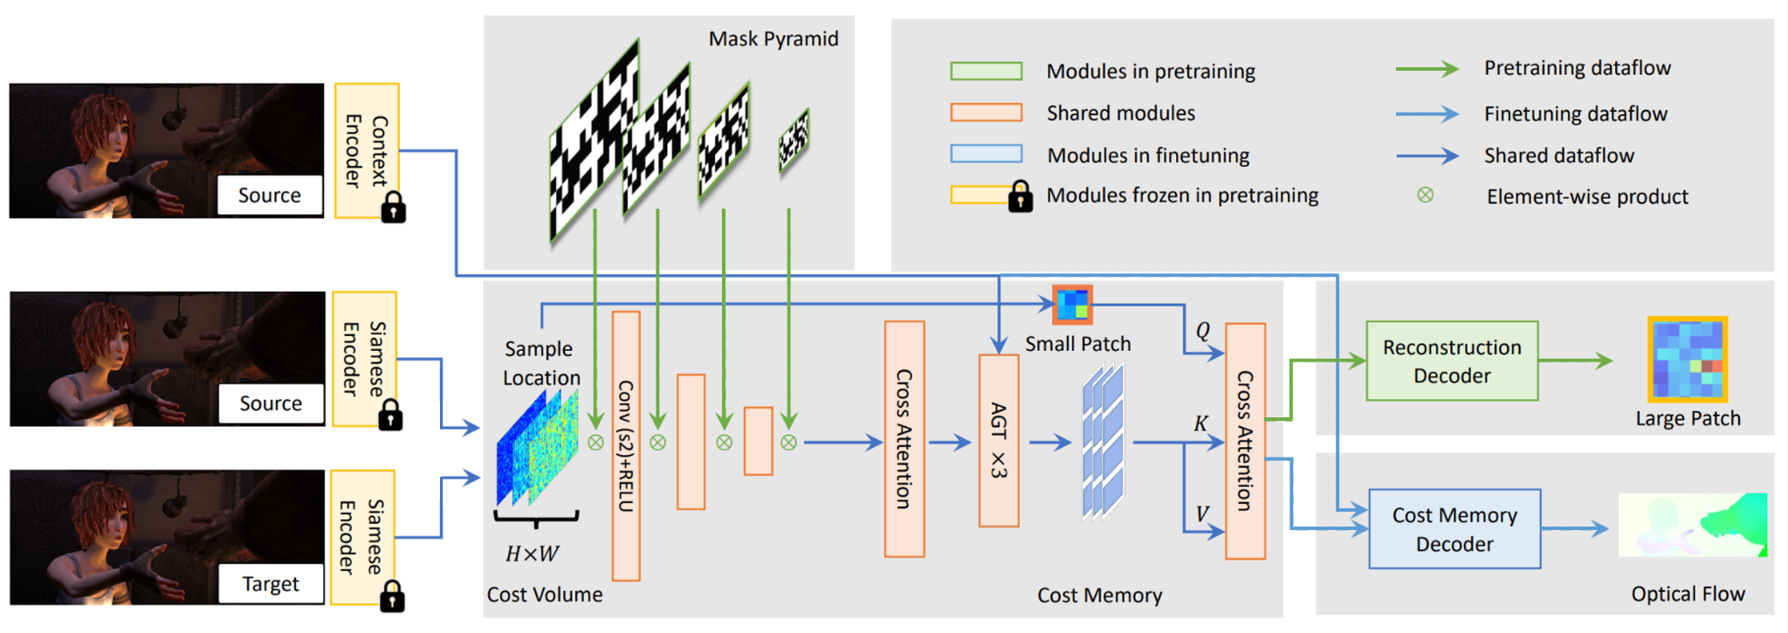
FlowFormer++
Fig. 1. FlowFormer++ architecture.
4
4
Notes:
高斯約束層
4

Slide 5
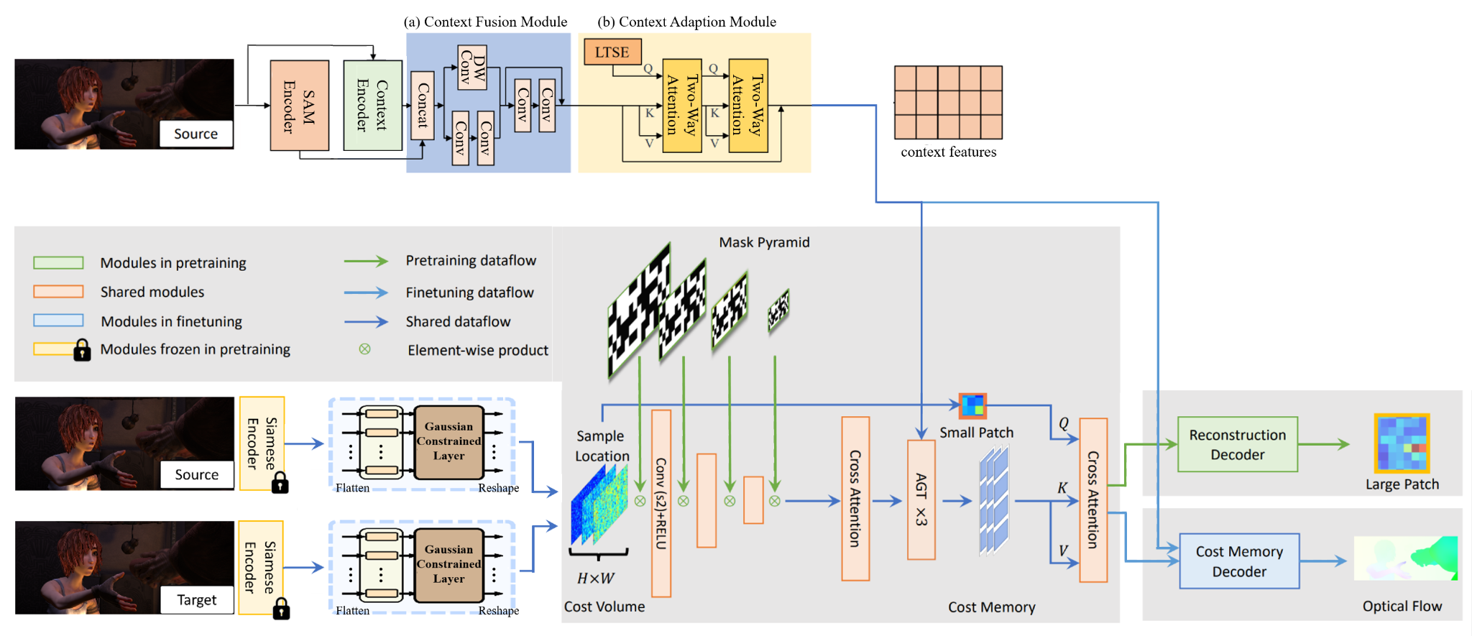
Proposed Approach
Fig. 2. Framework of the proposed approach.
5
5
Notes:
5

Slide 6
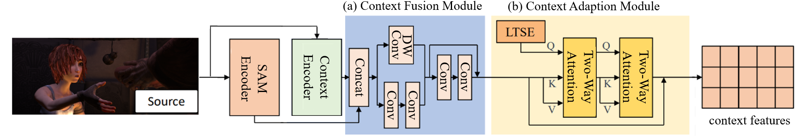
Proposed Approach (cont.)
The pretrained SAMFlow architecture containing context fusion module (CFM) and context adaption module (CAM) is shown in Fig. 3.
Fig. 3. The pretrained SAMflow architecture.
6
6
Notes:
6

Slide 7
Proposed Approach (cont.)
Context fusion module (CFM) fuses outputs of SAM encoder and context encoder to prevent task mismatch of local features and improves the effectiveness of SAMFlow.
CFM will combine global understanding extracted by SAM encoder and local clues extracted by both SAM encoder and context encoder.
7
7
Notes:
7

Slide 8
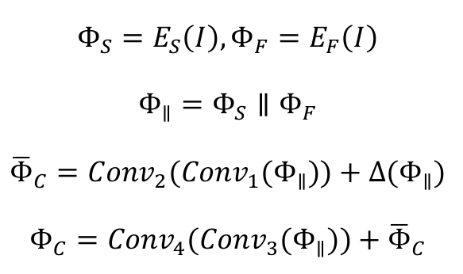
Proposed Approach (cont.)
CFM combines SAM encoder and context encoder to extract more comprehensive features:
8
8
Notes:
8

Slide 9
Proposed Approach (cont.)
Context adaption module (CAM) can better utilize the task specific knowledge to accomplish task adaption of optical flow estimation.
Learned task-specific embedding (LTSE) tokens are employed to store some task specific priors of optical flow, and two two-way attention (TWA) blocks are employed to inject those priors into context features for adaption.
9
9
Notes:
9

Slide 10
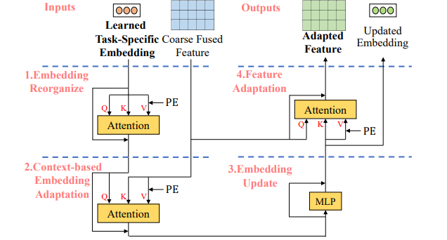
Proposed Approach (cont.)
LTSE containing a set of learnable offsets of shape 3×256 will be automatically optimized during the training process.
As shown in Fig. 4, each TWA block contains four sub-blocks:
10
10
Fig. 4. Architecture of TWA block.
Notes:
10

Slide 11
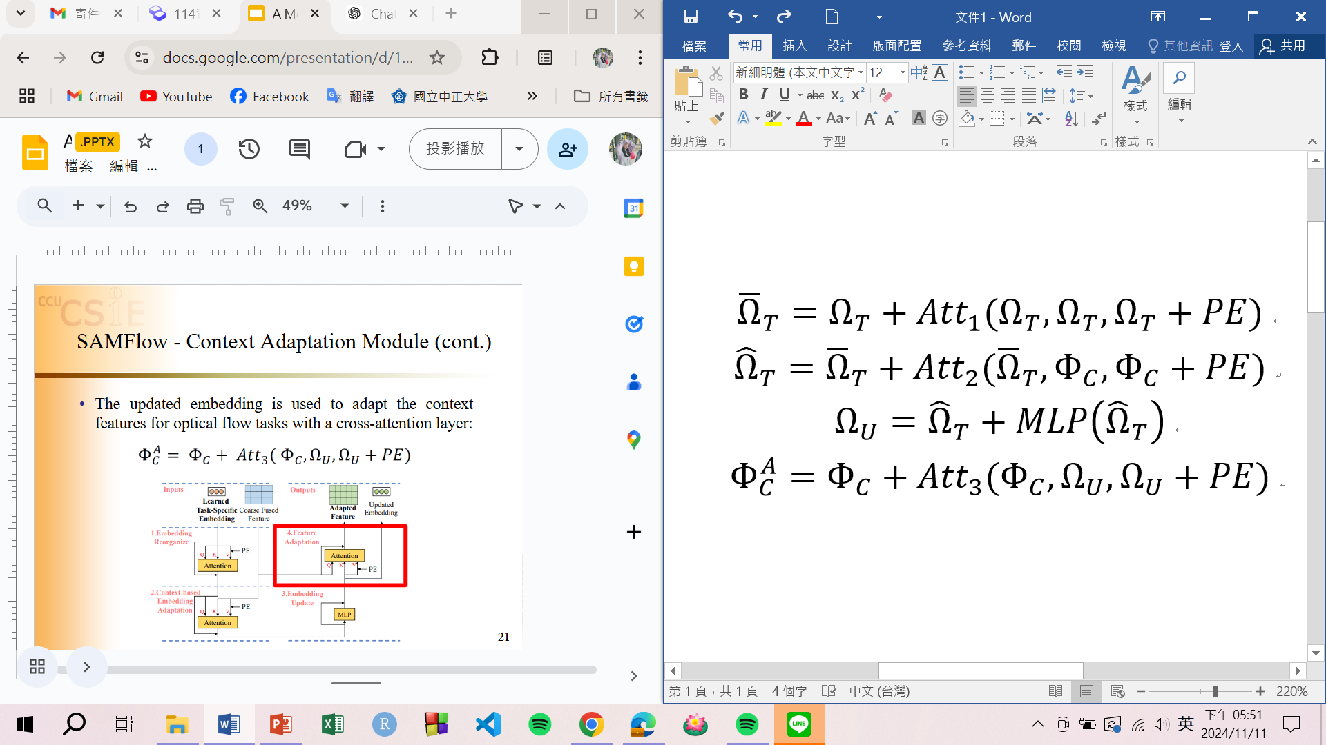
Proposed Approach (cont.)
A self-attention layer (1st sub-block) is used to reorganize the embedding of optical flow estimation task (the output of LTSE):
where denotes positional embedding.
A cross-attention layer (2nd sub-block) is used to adapt the embedding with context features:
where denotes the output of CFM.
11
11
Notes:
11

Slide 12
Proposed Approach (cont.)
A multi-layer perceptron (MLP) (3rd sub-block) is used to update the query:
A cross-attention layer (4th sub-block) is used to adapt the context features for optical flow estimation:
12
12
Notes:
12

Slide 13
Proposed Approach (cont.)
Gaussian constrained layer (GCL) fortified with a learnable Gaussian kernel, naturally prioritizes the local surroundings of each pixel, thus effectively enhances the feature discrimination for cross-frame matching.
GCL can obtain the fine-grained structural information and locally discriminative representations for feature matching.
13
13
Notes:
GCL 透過可學習的高斯核進行強化，自然地優先考慮每個點的局部環境，從而有效增強了跨幀匹配的特徵區分度。
GCL 可以獲得細粒度的結構資訊和用於特徵匹配的局部判別表示。
13

Slide 14
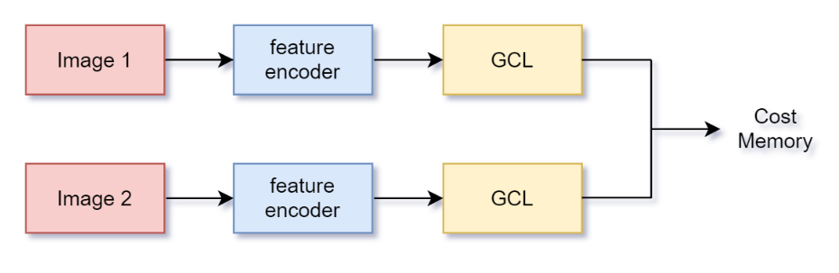
Proposed Approach (cont.)
As shown in Fig. 5, GCL is integrated into FlowFormer++ encoder, which processes extracted features before generating the cost volume.
source
frame
x
y
Cost
Volume
target
frame
x
y
Fig. 5. Architecture of the proposed cost volume encoder.
14
14
Notes:
14

Slide 15
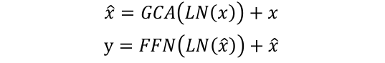
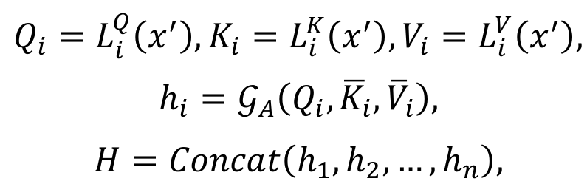
Proposed Approach (cont.)
For input feature x, the output y of GCL is defined as:
where GCA (Gaussian constrained attention) is a task-specific local operation:
FFN(∙) denotes feed-forward network, and LN(∙) denotes layer normalization.
15
15
Notes:
x為input，LN(·) 表示Transformer中的layer normalization ，FFN(·)表示前饋網絡，GCA(·) 表示高斯約束注意力(GCL中的核心組件)。
將GCA公式化為一種任務特定的局部操作，這不僅避免了全局誤導context，還降低了注意力計算的複雜性。
x’ = LN(x)，L()表示第i個head的線性投影，GA(·) 是高斯注意力函數。
15

Slide 16

Proposed Approach (cont.)
In this study,
$𝒢_{A}\left(Q, \overline{K}, \overline{V}\right)=Softmax(G_{lr}∙(Q{\overline{K}}^{T})/\sqrt{d})∙\overline{V},$
$h_{p}, p=1, 2, …, n$ is defined as
$h_{p}=Softmax(G_{lr}∙{\left(Q_{\left(p\right)}\overline{K}\right)}_{N\left(p\right)}^{T}/\sqrt{d})∙{\overline{V}}_{N(p)},$
and $Concat(∙, ∙, …, ∙)$ denotes concatenation operation.
16
16
Notes:
GA(·) 是高斯注意力函數，它的輸入​為特徵 Q​ 及以其查詢對應的key K​ 和value V。
Glr​ 表示形狀為 k×k 的可學習高斯核。它初始化為標準高斯分布，並可通過在模型訓練過程中加入可學習幅度矩陣 A 來進行更新。在推理過程中，Glr​ 作為約束掩碼(constraint mask)來重新組織注意特徵聚合(attentive feature aggregation)的權重。
設點p處pixel的neighborhood為 N(p)；則hp為單個pixel的注意力。
範圍可以隨著 N(p) 的區域變化而擴展。例如，它可以擴展到所有像素（即 N(p) 等同於影像大小），從而以高斯約束的方式實現全局自注意力。
16

Slide 17
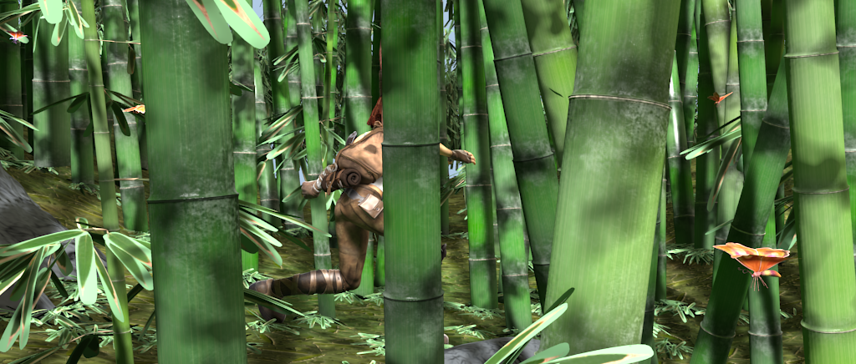
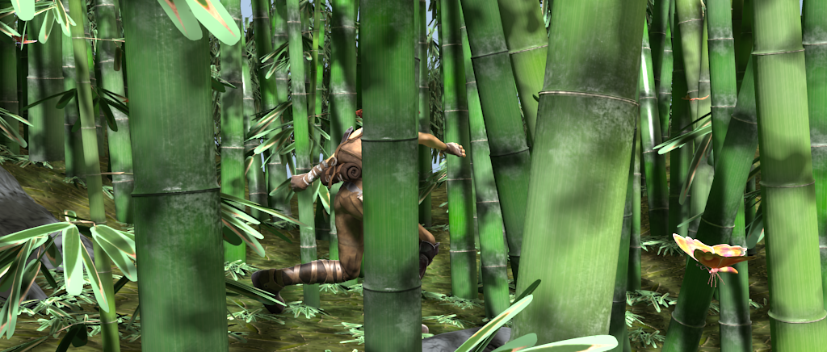


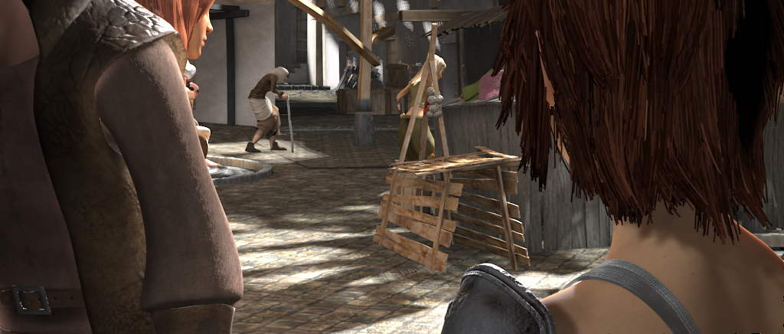
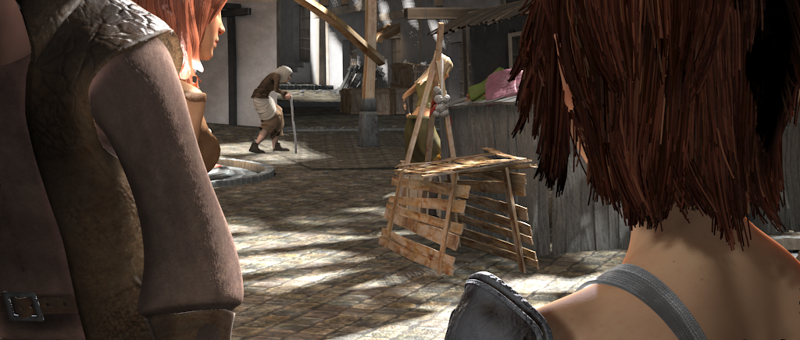

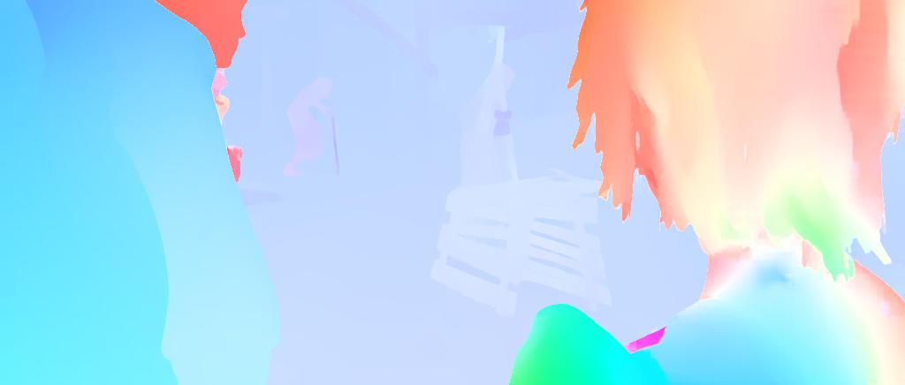
Experimental Results
Source frame
Target frame
FlowFormer++
Proposed
Fig. 6. Visual comparisons between FlowFormer++ and the proposed approach on two samples of Sintel dataset.
17
17
Notes:
17

Slide 18
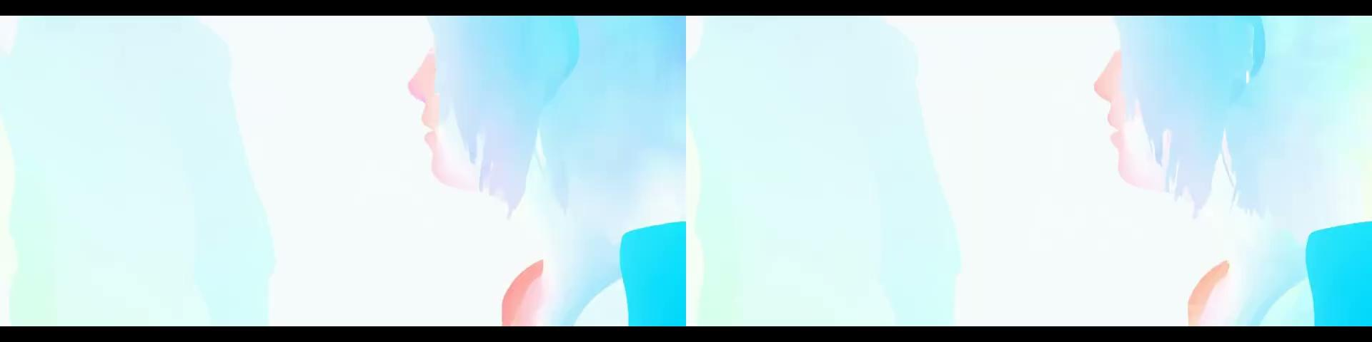
Experimental Results (cont.)
Fig. 7. Visual comparisons between FlowFormer++ and the proposed approach on one video sequence of Sintel dataset.
18
18
Notes:
18

Slide 19
Experimental Results (cont.)
Table 1. In terms of average EPE and F1-all, performance comparisons between FlowFormer++ and the proposed approach on Sintel and KITTI datasets.
 | Sintel |  | KITTI
metrics approaches | EPE-clean | EPE-final | EPE-F1 | F1-all
FlowFormer++ | 0.90 | 2.30 | 3.93 | 14.13
Proposed | 0.85 | 2.05 | 3.96 | 13.86
19
19
Notes:
19

Slide 20
Concluding Remarks
In this study, a modified optical flow estimation approach with SAM and GCL is proposed.
Based on the experimental results obtained in this study, in terms of two performance metrics and subjective evaluation, the performance of the proposed approach is better than that of FlowFormer++.
20
20
Notes:
20

Slide 21
Thanks for your attention!
21
Notes:
21

